Slide 1
Spatial Indexing I
Point Access Methods

Slide 2
Spatial Indexing
Point Access Methods (PAMs) vs Spatial Access Methods (SAMs)
PAM: index only point data
  Hierarchical (tree-based) structures
  Multidimensional Hashing
  Space filling curve
SAM: index both points and regions
  Transformations
  Overlapping regions
  Clipping methods

Slide 3
The problem
Given a point set and a rectangular query, find the points enclosed in the query
Query

Slide 4
Grid File
Hashing methods for multidimensional points (extension of Extensible hashing)
Idea: Use a grid to partition the space→ each cell is associated with one page
Two disk access principle (exact match)

Slide 5
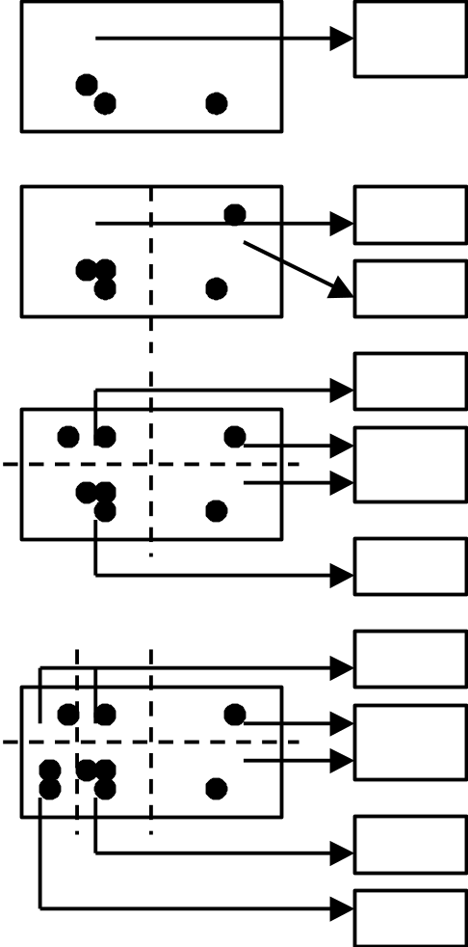
Grid File
Space Partitioning strategy but different from a tree.
Select dividers along each dimension. Partition space into cells
Dividers cut all the way.
Each cell corresponds to 1 disk page.
Many cells can point to the same page.
Cell directory potentially exponential in the number of dimensions

Slide 6
Grid File Implementation
Dynamic structure using a grid directory
  Grid array: a 2 dimensional array with pointers to buckets (this array can be large, disk resident) G(0,…, nx-1, 0, …, ny-1)
  Linear scales: Two 1 dimensional arrays that used to access the grid array (main memory) X(0, …, nx-1), Y(0, …, ny-1)

Slide 7
Example
Buckets/Disk
Blocks
Grid Directory
Linear scale
Y
Linear scale X

Slide 8
Grid File Search
Exact Match Search: at most 2 I/Os assuming linear scales fit in memory.
  First use liner scales to determine the index into the cell directory
  access the cell directory to retrieve the bucket address (may cause 1 I/O if cell directory does not fit in memory)
  access the appropriate bucket (1 I/O)
Range Queries:
  use linear scales to determine the index into the cell directory.
  Access the cell directory to retrieve the bucket addresses of buckets to visit.
  Access the buckets.

Slide 9
Grid File Insertions
Determine the bucket into which insertion must occur.
If space in bucket, insert.
Else, split bucket
  how to choose a good dimension to split?
If bucket split causes a cell directory to split do so and adjust linear scales.
insertion of these new entries potentially requires a complete reorganization of the cell directory--- expensive!!!

Slide 10
Grid File Deletions
Deletions may decrease the space utilization. Merge buckets
We need to decide which cells to merge and a merging threshold
Buddy system and neighbor system
  A bucket can merge with only one buddy in each dimension
  Merge adjacent regions if the result is a rectangle

Slide 11
Tree-based PAMs
Most of tb-PAMs are based on kd-tree
kd-tree is a main memory binary tree for indexing k-dimensional points
  Needs to be adapted for disk model
Levels rotate among the dimensions, partitioning the space based on a value for that dimension
kd-tree is not necessarily balanced

Slide 12
kd-tree
At each level we use a different dimension
x=5
C
B
y=3
y=6
A
E
D
x=6

Slide 13
Kd-tree properties
Height of the tree O(log n)
Search time for exact match: O(log n)
Search time for range query: O(n^{1/2} + k)

Slide 14
kd-tree example
X=3
X=7
X=5
y=6
y=5
Y=6
x=8
x=7
x=3
y=2
Y=2
X=5
X=8

Slide 15
External memory kd-trees
Similar to B-tree, tree nodes split many ways instead of two ways
    insertion becomes quite complex and expensive.
    No storage utilization guarantee since when a higher level node splits, the split has to be propagated all the way to leaf level resulting in many empty blocks.
Pack many interior nodes (forming a subtree) into a block.
    it may not be feasible to group nodes at lower level into a block productively.
    Many interesting papers on how to optimally pack nodes into blocks recently published.

Slide 16
LSD-tree
Local Split Decision – tree
Use kd-tree to partition the space. Each partition contains up to B points. The kd-tree is stored in main-memory.
If the kd-tree (directory) is large, we store a sub-tree on disk
Goal: the structure must remain balanced: external balancing property

Slide 17
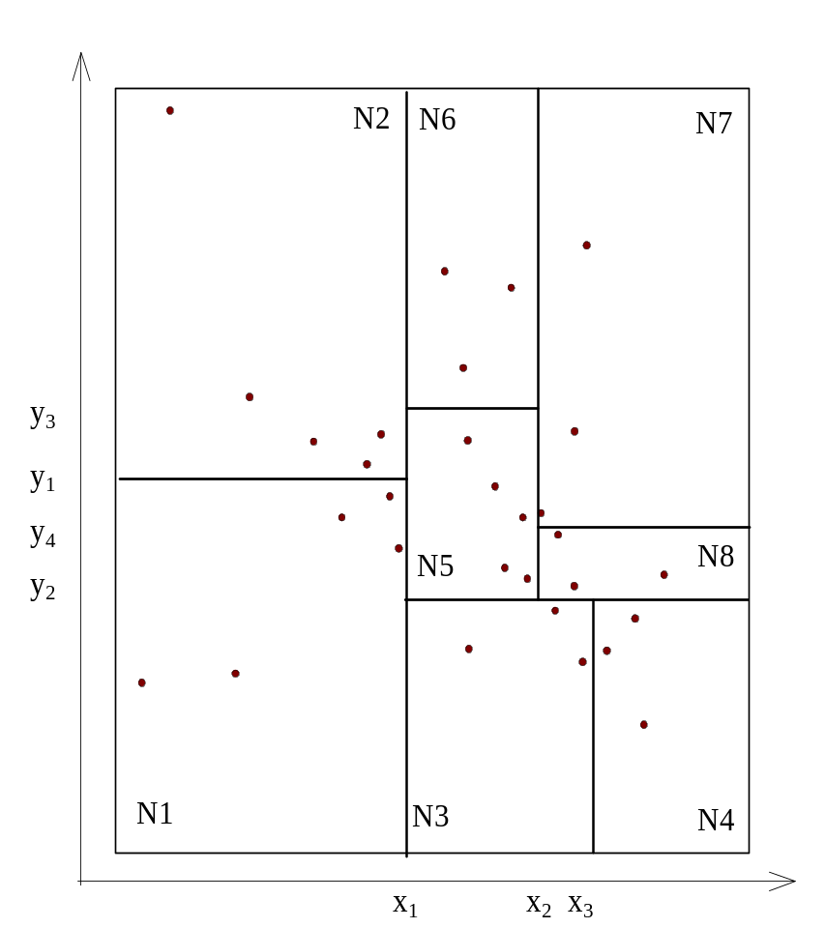
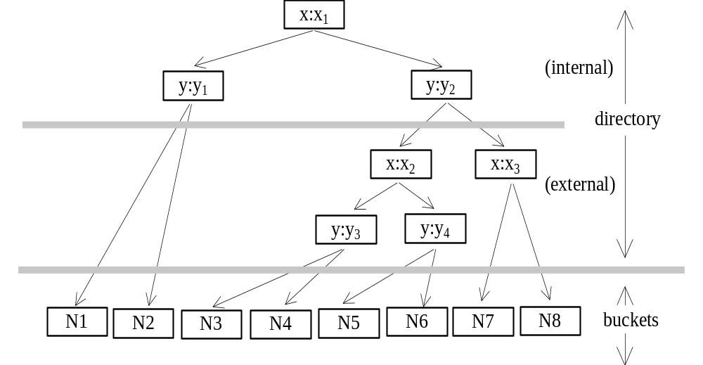
Example: LSD-tree

Slide 18
LSD-tree: main points
Split strategies:
  Data dependent
  Distribution dependent
Paging algorithm
Two types of splits: bucket splits and internal node splits

